Slide 1
ECE 408/CS483 Applied Parallel Programming Generalization and Future Studies Computational Thinking 101

Slide 2
Objective
To provide you with a framework for further studies on
Thinking about the problem of parallel programming
Discussing your work with others
Addressing performance and functionality issues in your parallel program
Using or building useful tools and environments
understanding case studies and projects

Slide 3
Fundamentals of Parallel Computing
Parallel computing requires that
The problem can be decomposed into sub-problems that can be safely solved at the same time
The programmer structures the code and data to solve these sub-problems concurrently
The goals of parallel computing are
To solve problems in less time, and/or
To solve bigger problems, and/or
To achieve better solutions
The problems must be large enough to justify parallel computing and to exhibit exploitable concurrency.

Slide 4
A Recommended Reading
Mattson, Sanders, Massingill, Patterns for Parallel Programming, Addison Wesley, 2005, ISBN 0-321-22811-1.
We draw quite a bit from the book
A good overview of challenges, best practices, and common techniques in all aspects of parallel programming

Slide 5
Shared Memory vs. Message Passing
We have focused on shared memory parallel programming
This is what CUDA (and OpenMP, OpenCL) is based on
Future massively parallel microprocessors are expected to support shared memory at the chip level
This is different than global address space (single pointer space)
The programming considerations of message passing model is quite different!
We will discuss MPI (Message Passing Interface) and use it with CUDA

Slide 6
Data Sharing
Data sharing can be a double-edged sword
Excessive data sharing can drastically reduce advantage of parallel execution
Localized sharing can improve memory bandwidth efficiency
Efficient memory bandwidth usage can be achieved by synchronizing the execution of task groups and coordinating their usage of memory data
Efficient use of on-chip, shared storage
Read-only sharing can usually be done at much higher efficiency than read-write sharing, which often requires synchronization

Slide 7
Data Sharing Example – Matrix Multiplication
Each task group will finish usage of each sub-block of N and M before moving on
N and M sub-blocks loaded into Shared Memory for use by all threads of a P sub-block
Amount of on-chip Shared Memory strictly limits the number of threads working on a P sub-block
Read-only shared data can be more efficiently accessed as Constant data

Slide 8
Parallel Programming Coding Styles - Program and Data Models
Program Models
Data Models
SPMD
Shared Data
Master/Worker
Shared Queue
Loop Parallelism
Distributed Array
Fork/Join
These are not necessarily mutually exclusive.

Slide 9
Program Models
SPMD (Single Program, Multiple Data)
All PE’s (Processor Elements) execute the same program in parallel, but has its own data
Each PE uses a unique ID to access its portion of data
Different PE can follow different paths through the same code
This is essentially the CUDA Grid model (also MPI)
SIMD is a special case - WARP
Master/Worker (CUDA Streams)
Loop Parallelism (OpenMP)
Fork/Join (Posix p-threads)

Slide 10
Program Models
SPMD (Single Program, Multiple Data)
Master/Worker
A Master thread sets up a pool of worker threads and a bag of tasks
Workers execute concurrently, removing tasks until done
Loop Parallelism
Loop iterations execute in parallel
FORTRAN do-all (truly parallel), do-across (with dependence)
Fork/Join
Most general, generic way of creation of threads

Slide 11
Review: Algorithm Structure
Start
Organize
by Task
Organize by
Data
Organize by
Data Flow
Linear
Recursive
Linear
Recursive
Regular
Irregular
Task
Parallelism
Divide and
Conquer
Geometric
Decomposition
Recursive
Data
Pipeline
Event Driven

Slide 12
Algorithm Structures vs. Coding Styles
 | Task Parallel. | Divide/Conquer | Geometric Decomp. | Recursive Data | Pipeline | Event-based
SPMD | ☺☺☺☺ | ☺☺☺ | ☺☺☺☺ | ☺☺ | ☺☺☺ | ☺☺
Loop Parallel | ☺☺☺☺ | ☺☺ | ☺☺☺
Master/Worker | ☺☺☺☺ | ☺☺ | ☺ | ☺ | ☺ | ☺
Fork/ Join | ☺☺ | ☺☺☺☺ | ☺☺ |  | ☺☺☺☺ | ☺☺☺☺
Source: Mattson, et al

Slide 13
Programming Models vs. Program Models
 | OpenMP | MPI | CUDA/ OpenCL
SPMD | ☺☺☺ | ☺☺☺☺ | ☺☺☺☺☺
Loop Parallel | ☺☺☺☺ | ☺
Master/ Slave | ☺☺ | ☺☺☺ | ☺☺
Fork/Join | ☺☺☺

Slide 14
More on SPMD
Dominant coding style of scalable parallel computing
MPI code is mostly developed in SPMD style
Many OpenMP code is also in SPMD (next to loop parallelism)
Particularly suitable for algorithms based on task parallelism and geometric decomposition.
Main advantage
Tasks and their interactions visible in one piece of source code, no need to correlated multiple sources
SPMD is by far the most commonly used pattern for structuring parallel programs.

Slide 15
Typical SPMD Program Phases
Initialize
Establish localized data structure and communication channels
Obtain a unique identifier
Each thread acquires a unique identifier, typically range from 0 to N=1, where N is the number of threads.
Both OpenMP and CUDA have built-in support for this.
Distribute Data
Decompose global data into chunks and localize them, or
Sharing/replicating major data structure using thread ID to associate subset of the data to threads
Run the core computation
More details in next slide…
Finalize
Reconcile global data structure, prepare for the next major iteration

Slide 16
Core Computation Phase
Thread IDs are used to differentiate behavior of threads
Use thread ID in loop index calculations to split loop iterations among threads
Use thread ID or conditions based on thread ID to branch to their specific actions
Both can have very different performance results and code complexity depending on the way they are done.

Slide 17
A Simple Example
Assume
The computation being parallelized has 1,000,000 iterations.
Sequential code:
Num_steps = 1000000;
for (i=0; i< num_steps, i++) {
…
}

Slide 18
SPMD Code Version 1
Assign a chunk of iterations to each thread
The last thread also finishes up the remainder iteartions
//num_steps = 1000000;
…
i_start = my_id * (num_steps/num_threads);
i_end = i_start + (num_steps/num_threads);
if (my_id == (num_threads-1)) i_end = num_steps;
for (i = i_start; i < i_end; i++) {
….
}
Reconciliation of results across threads if necessary.

Slide 19
Problems with Version 1
The last thread executes more iterations than others
The number of extra iterations is up to the total number of threads – 1
This is not a big problem when the number of threads is small
When there are thousands of threads, this can create serious load imbalance problems.
Also, the extra if statement is a typical source of “branch divergence” in CUDA programs.

Slide 20
SPMD Code Version 2
Assign one more iteration to some of the threads
int rem = num_steps % num_threads;
i_start = my_id * (num_steps/num_threads);
i_end = i_start + (num_steps/num_threads);
if (rem != 0) {
if (my_id < rem) {
i_start += my_id;
i_end += (my_id +1);
}
else {
i_start += rem;
i_end += rem;
}
.
Less load imbalance
More branch divergence.

Slide 21
SPMD Code Version 3
Use cyclic distribution of iteration
num_steps = 1000000;
for (i = my_id; i < num_steps; i+= num_threads) {
….
}
Less load imbalance
Loop branch divergence in the last Warp
Data padding further eliminates divergence.

Slide 22
Comparing the Three Versions
Version 1
ID=0
ID=1
ID=2
ID=3
Version 2
ID=0
ID=1
ID=2
ID=3
Version 3
ID=0
ID=1
ID=2
ID=3
Padded version 3 may be best
for some data access patterns.

Slide 23
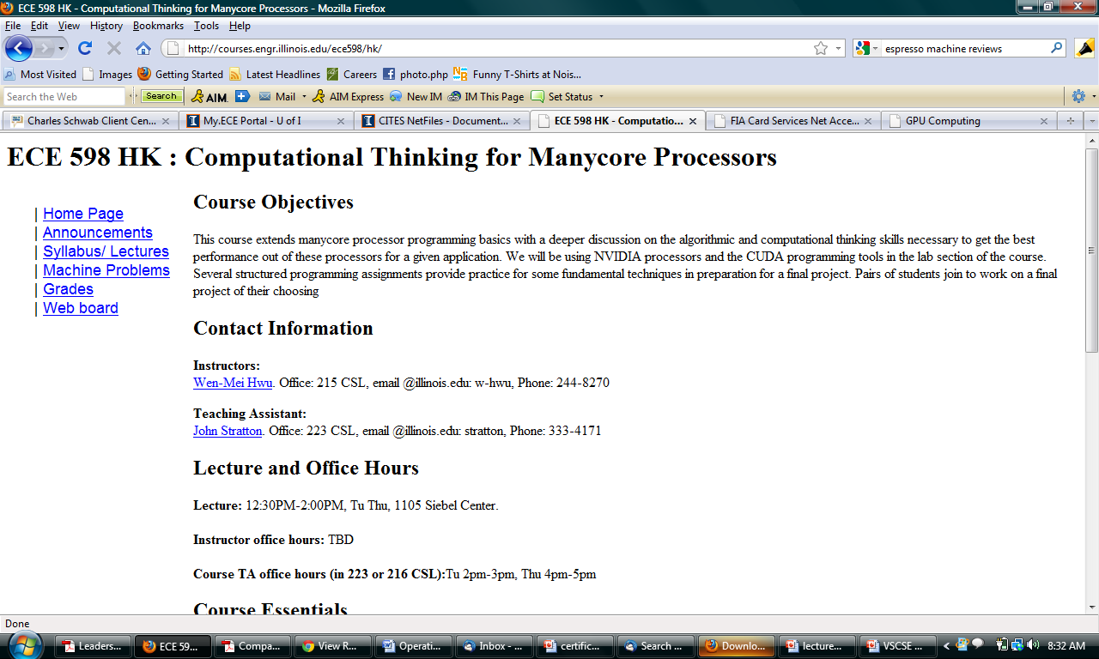
ECE 598HK courses.ece.uiuc.edu/ece598/hk

Slide 24
Eight Optimization Patterns for Algorithms (so far)
http://courses.engr.illinois.edu/ece598/hk/
GPU Computing Gems, Vol. 1 and 2

Slide 25
Benefit from other people’s experience
GPU Computing Gems Vol 1 (Emerald)
50 gems in 10 applications areas
Scientific simulation, life sciences, statistical modeling, emerging data-intensive applications, electronic design automation, computer vision, ray tracing and rendering, video and imaging processing, signal and audio processing, medical imaging
GPU Computing Gems Vol 2 (Jade)
40+ gems in more application areas, tools, environments

Slide 26
the GPUComputing.net Community

